Slide 1
Tennis Ball Tracking
IACV
Felipe Azank and Felipe Bagni

Slide 2
Table of contents
01
02
03
04
05
06
Problem
Literature Review
Methodology
Implementation
Analysis & Results
Conclusions

Slide 3
01 & 02
Problem &
Literature Review

Slide 4
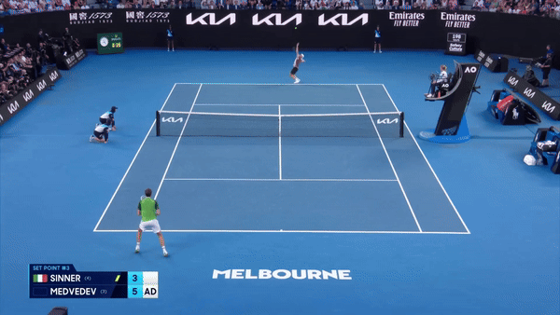
Problem Description
Objective
Given an input video of a tennis rally in a standard view, obtain:
The time (frame) in which the ball bounces in the court or is hit by a racket;
The position of the ball in those frames.
This allows, for instance:
Valuable match insights;
Assess player performance;
Strategize gameplay;
Enhance training techniques.

Slide 5
Literature Review
Ball tracking
Court detection
Image rectification
Court detection was done using the Hough Transform. In this project, the OpenCV function cv2.HoughLinesP() was applied to detect the court lines. These detected lines are categorized into horizontal and vertical groups, after which lines corresponding to the same one are merged. [3][5]
The literature
behind this approach was based on what was seen during the Lessons and Practices of
the discipline itself. [1][4]
Previous works
have demonstrated the effectiveness of CNN techniques in accurately identifying and fol-
lowing objects within video sequences, particularly in dynamic environments like sports. [2]

Slide 6
03
Methodology

Slide 7
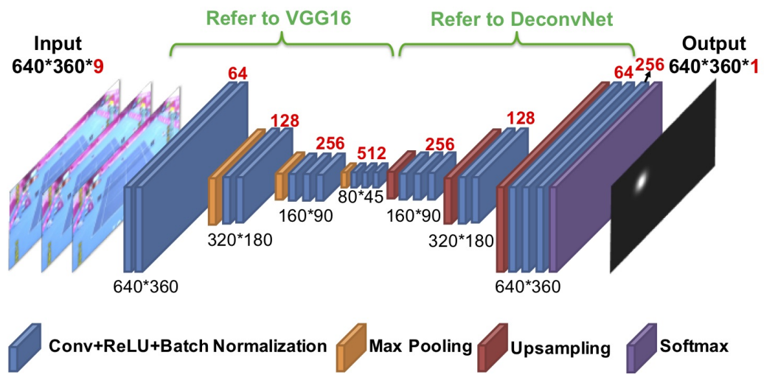
Tracking of the ball
TrackNet
In order to obtain the coordinates of the ball during the rally, we used TrackNet, a Convolutional Neural Network specialized on high speed ball detection in sports.
The output of this phase should be (for each frame):
The coordinate X and Y of the tennis ball identified in that frame (w.r.t. the video, not the tennis court)

Slide 8
Bounce moment identification
Derivative Approach
Neighbourhood Values Approach
A bounce is detected when the ball's vertical velocity (first derivative of position) reaches zero and its acceleration (second derivative) becomes positive, marking a local minimum as the ball hits the ground and bounces. Racket hits are identified by sudden changes in both the magnitude and direction of the velocity, signaling the ball has been struck.
The second approach applied a simpler solution, basically looking at which values of the X and Y coordinates (separately) the data shows a local minima. After that, a filtering of the peaks was applied to avoid the identification of the same bounce more than once
The output of this phase should be:
The frames in which a bounce or racket hit occurs

Slide 9
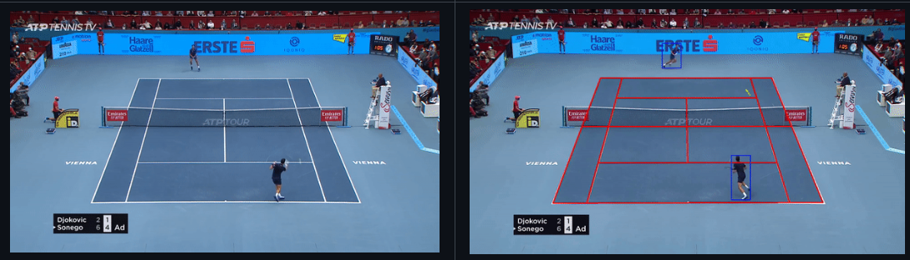
Court Identification
Input
Convert Frame to Grayscale
Binarize the Grayscale Image and filter it
Detect Line Segments
Estimate Homography Matrix and validate accuracy.
Track Court Lines in Subsequent Frames
Calculate and Sort Intersection Points
Output
Notes:
Convert Frame to Grayscale: The CourtDetector starts by converting the input video frame from BGR to grayscale using cv2.cvtColor. This simplifies the image and focuses on intensity values rather than color.
Binarize the Grayscale Image: The grayscale image is then binarized using cv2.threshold, where bright pixels (court lines) are set to white, and the rest of the pixels are set to black. This isolates the potential court lines from other features in the frame.
Filter the Binary Image: The _filter_pixels method refines the binary image by removing irrelevant pixels that don't exhibit significant intensity changes. This step ensures only pixels representing actual court lines are retained.
Detect Line Segments: Using the Hough Line Transform (cv2.HoughLinesP), the _detect_lines method identifies potential line segments in the filtered binary image. Parameters like minLineLength and maxLineGap fine-tune which lines are detected.
Estimate Homography Matrix: The _find_homography method estimates a transformation matrix by comparing the detected lines with a reference court model. This matrix is calculated using cv2.findHomography to map the detected lines to the predefined court layout.
Validate Homography Accuracy: A confidence score is computed to assess the accuracy of the homography matrix, ensuring the detected court lines align correctly with the reference court model.
Track Court Lines in Subsequent Frames: The track_court method updates the positions of court lines in subsequent video frames. It checks for significant deviations that could indicate camera movement and recalibrates if necessary.
Calculate and Sort Intersection Points: The line_intersection function calculates the intersection points of the detected lines using sympy.Line, while the sort_intersection_points function organizes these points for accurate alignment with the reference court layout.

Slide 10
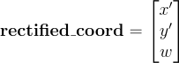
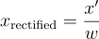
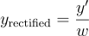
Image Rectification
Step 1 - Transformation Matrix
Step 2 - Coordinate Transform
The transformation from the original coordinates to the top view were obtained using a transformation matrix based on the camera’s intrinsic and extrinsic parameters, which helps to remove the effects of perspective distortion.
This matrix is one output of the Court Identification
With the matrix M we can then obtain the rectified version by:
And then, obtaining the final coordinates by:
The output of this phase should be:
The location of the ball in the rectified image on every frame in which a bounce was identified

Slide 11
04
Implementation

Slide 12
Implementation Summary
Data Gathering of the rallies
Tracking of the ball (NN implementation)
Choosing best input form
Data Pre-processing
Bounce moment Identification (strategy 1 and 2)
Court Identification
Image Rectification
Absolute coordinates extraction

Slide 13
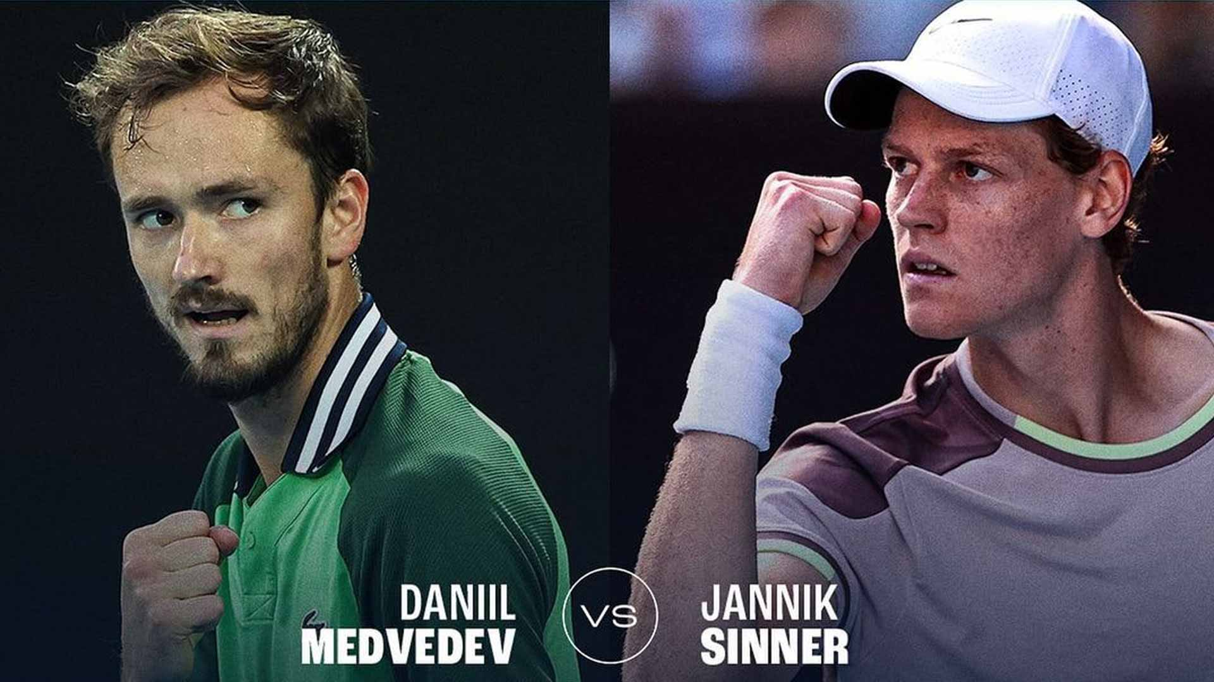
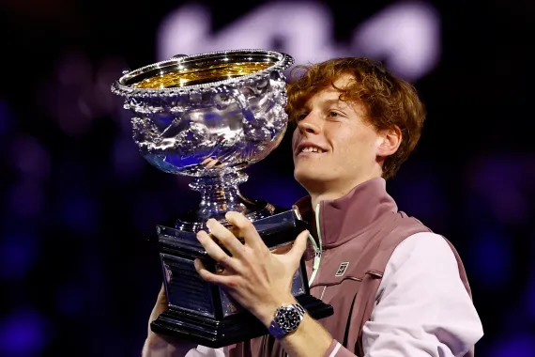
Data Gathering of the rallies
Main Data Souce
The main data source for the project was the match between Jannik Sinner and Daniil Medvedev for the Australian Open 2024 Final. The full match video was obtained in Youtube and many "cuts" were made manually in order to select the "rallies" in which a considerable amount of bounces could be obtained.

Slide 14
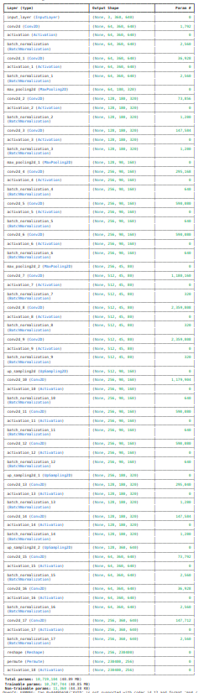
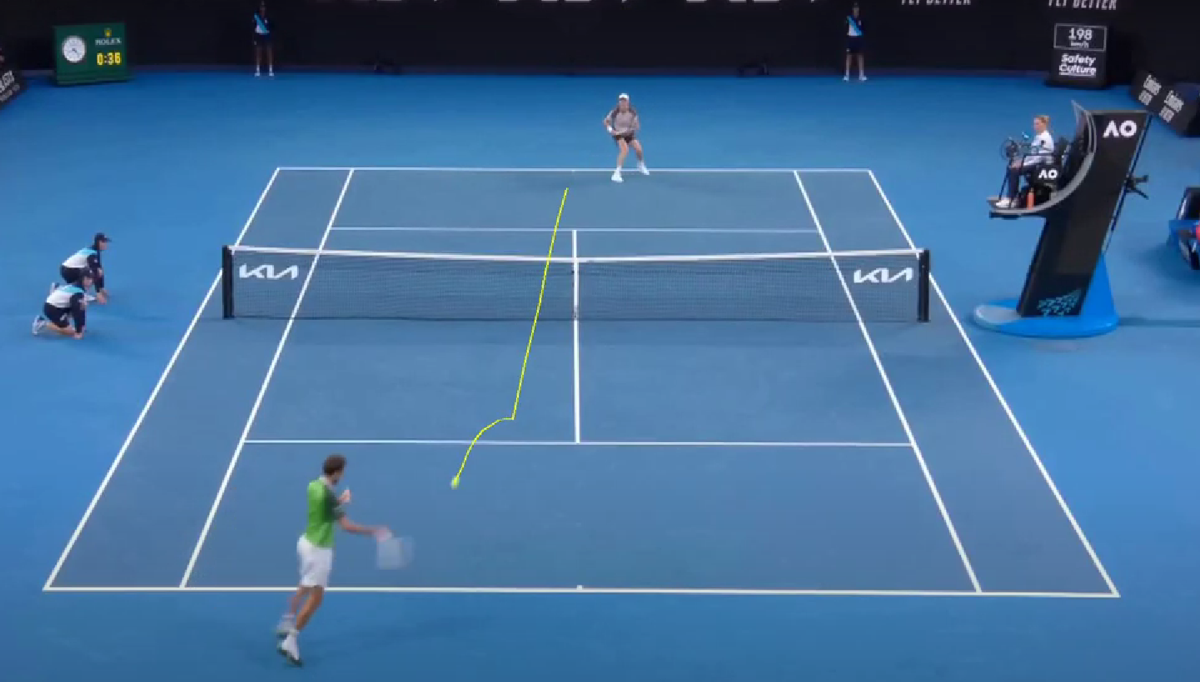
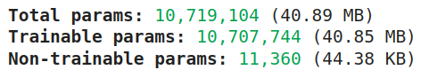
Ball Tracking and coordinates
TrackNet Implementation
For the tracking of the ball, we used an existing implementation of TrackNet available on GitHub. Several modifications to the original code to better suit our project requirements. Specifically, we adjusted the code to extract the full coordinates of the ball from each detected frame.

Slide 15
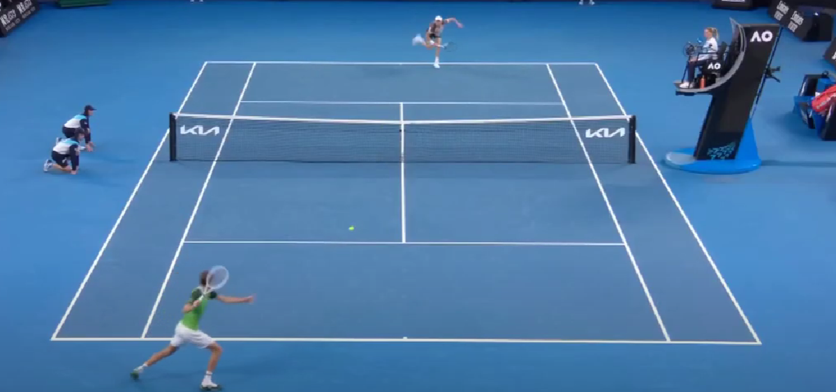
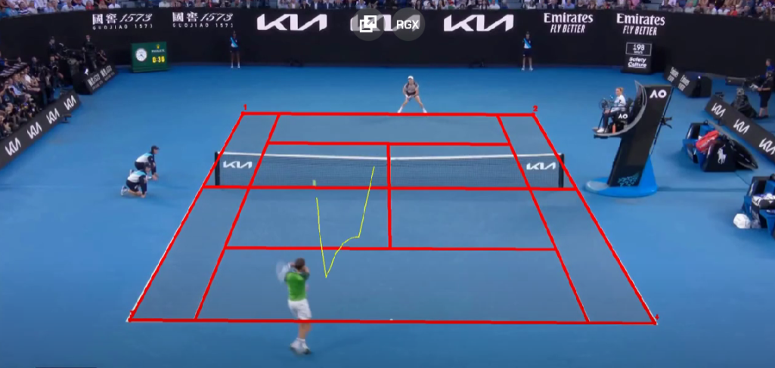
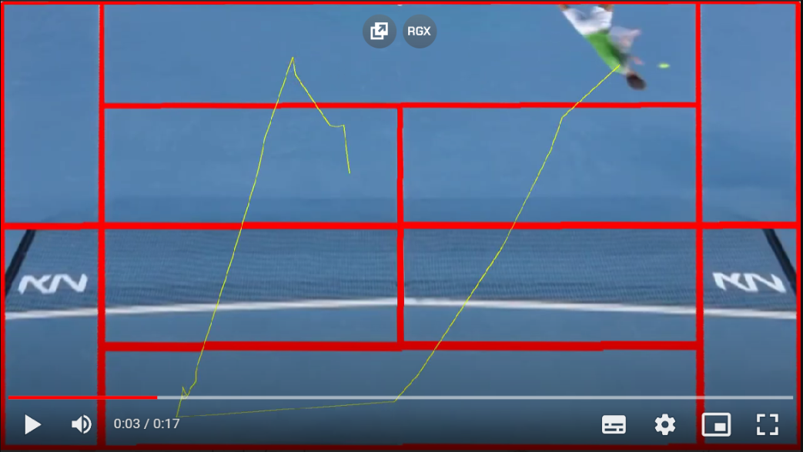
Choosing Best Input Form
Best input for the tracknet
During the implementation, 3 methods were tested as the input. The metric to choose the best one was done considering the amount of identified frames.
After some tests, the input that yielded the best results was the first one (given that it’s the most similar to the train test of the Tracknet).

Slide 16
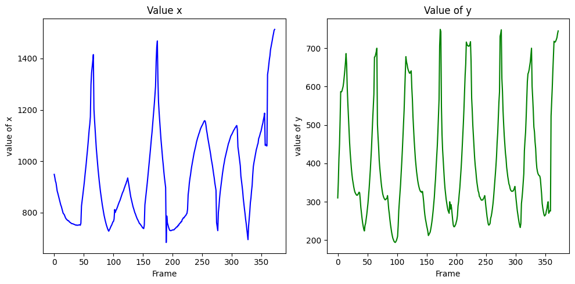
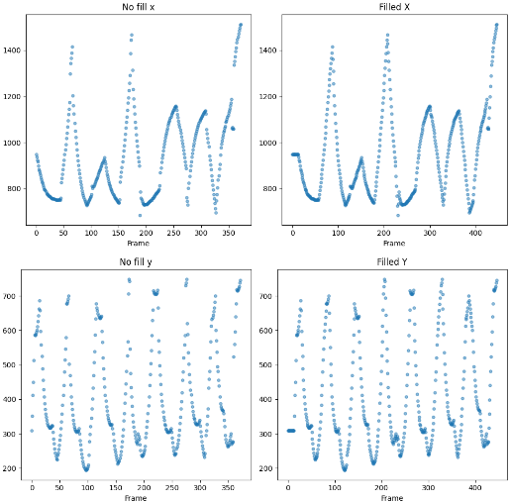
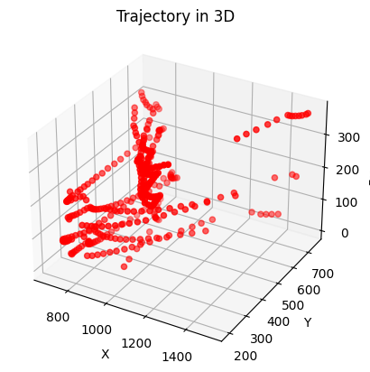
Data preprocessing

Slide 17
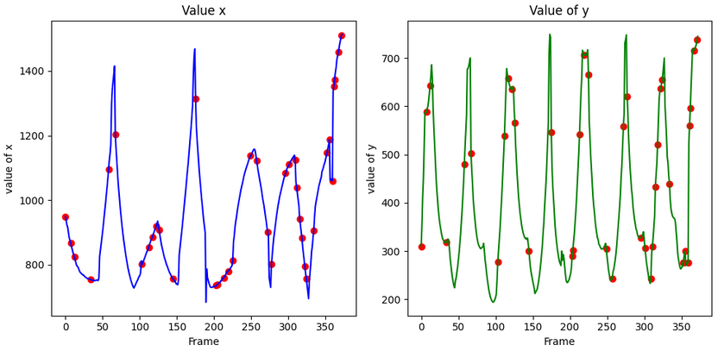
Bounce moment identification
Strategy 1
Using the gradient() function from NumPy to find the derivatives and find local minima using the change of sign from the second derivative of the positions where the first derivative equals zero.
The results of this strategy were not as good as expected, due to inflection points introduced by fitting a continuous trajectory on the discrete points distribution.

Slide 18
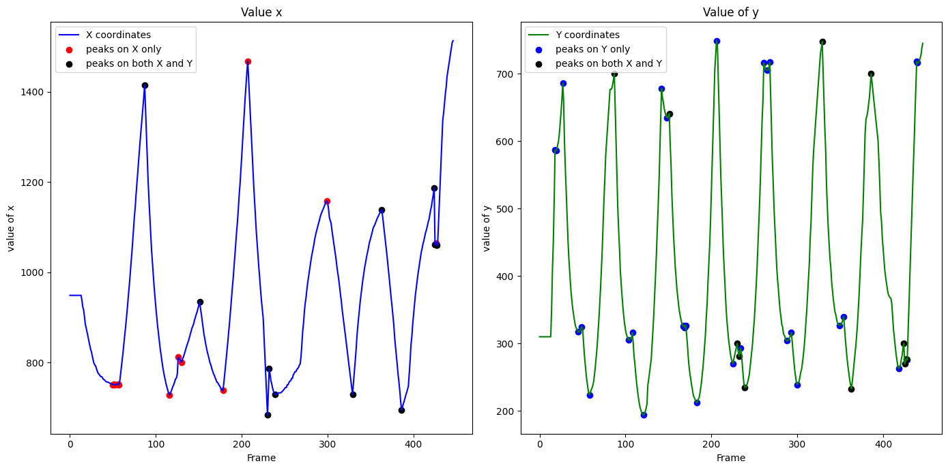
Bounce moment identification
Strategy 2
Using the find_peaks() function from SciPy to find the peaks (trend change) in the coordinates and doing it again on the negative array to find the valleys of the data.
After obtaining the peaks, we applied a padding, ignoring peaks identified in a range of 4 frames.

Slide 19
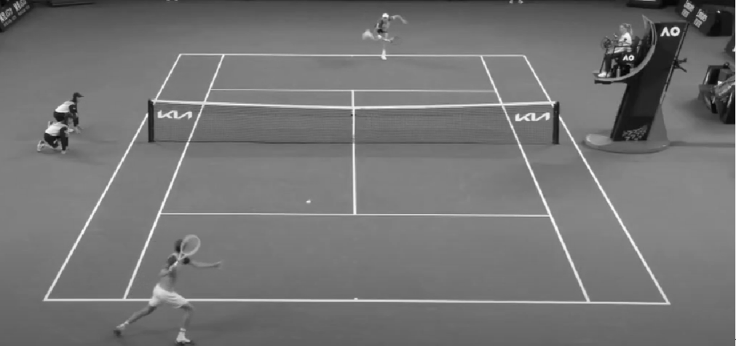
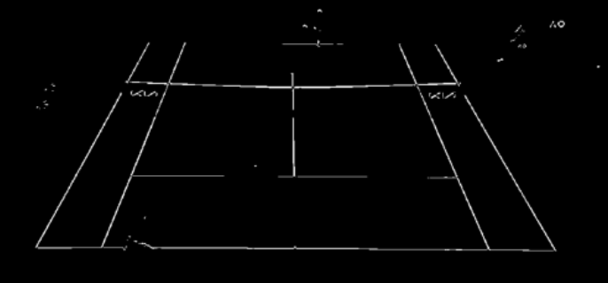
Court Identification
cv2.HoughLinesP()
Converted Frame to Grayscale
Binarized the Grayscale Image and filter it
Detected Line Segments Probabilistic
Input frame
sympy.Line()
cv2.findHomography()
Estimate Homography Matrix and validate accuracy.
Track Court Lines in Subsequent Frames
Calculate and Sort Intersection Points
Output
Notes:
Convert Frame to Grayscale: The CourtDetector starts by converting the input video frame from BGR to grayscale using cv2.cvtColor. This simplifies the image and focuses on intensity values rather than color.
Binarize the Grayscale Image: The grayscale image is then binarized using cv2.threshold, where bright pixels (court lines) are set to white, and the rest of the pixels are set to black. This isolates the potential court lines from other features in the frame.
Filter the Binary Image: The _filter_pixels method refines the binary image by removing irrelevant pixels that don't exhibit significant intensity changes. This step ensures only pixels representing actual court lines are retained.
Detect Line Segments: Using the Hough Line Transform (cv2.HoughLinesP), the _detect_lines method identifies potential line segments in the filtered binary image. Parameters like minLineLength and maxLineGap fine-tune which lines are detected.
Estimate Homography Matrix: The _find_homography method estimates a transformation matrix by comparing the detected lines with a reference court model. This matrix is calculated using cv2.findHomography to map the detected lines to the predefined court layout.
Validate Homography Accuracy: A confidence score is computed to assess the accuracy of the homography matrix, ensuring the detected court lines align correctly with the reference court model.
Track Court Lines in Subsequent Frames: The track_court method updates the positions of court lines in subsequent video frames. It checks for significant deviations that could indicate camera movement and recalibrates if necessary.
Calculate and Sort Intersection Points: The line_intersection function calculates the intersection points of the detected lines using sympy.Line, while the sort_intersection_points function organizes these points for accurate alignment with the reference court layout.

Slide 20
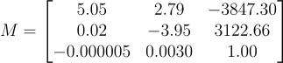
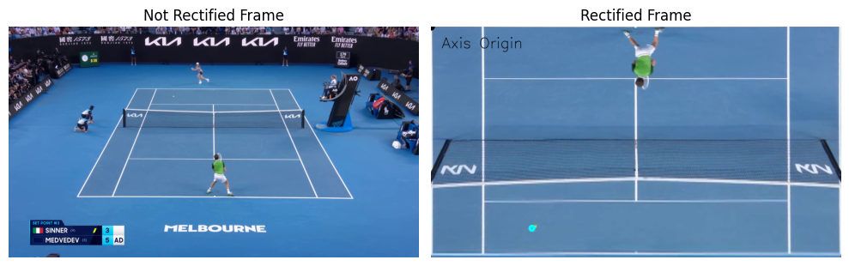
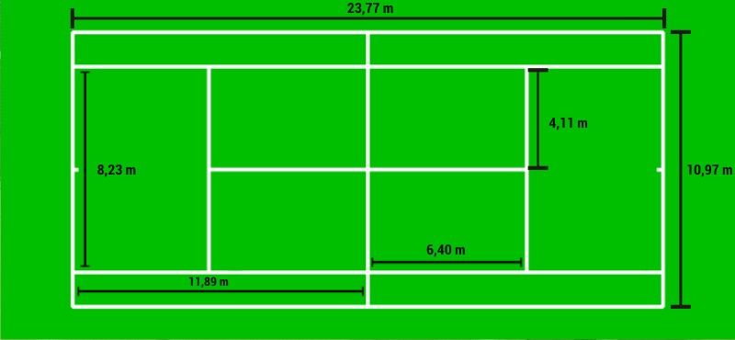
Image Rectification
From the output of the court detection, we could obtain the matrix
That generated the rectification:

Slide 21
05
Analysis & Results

Slide 22
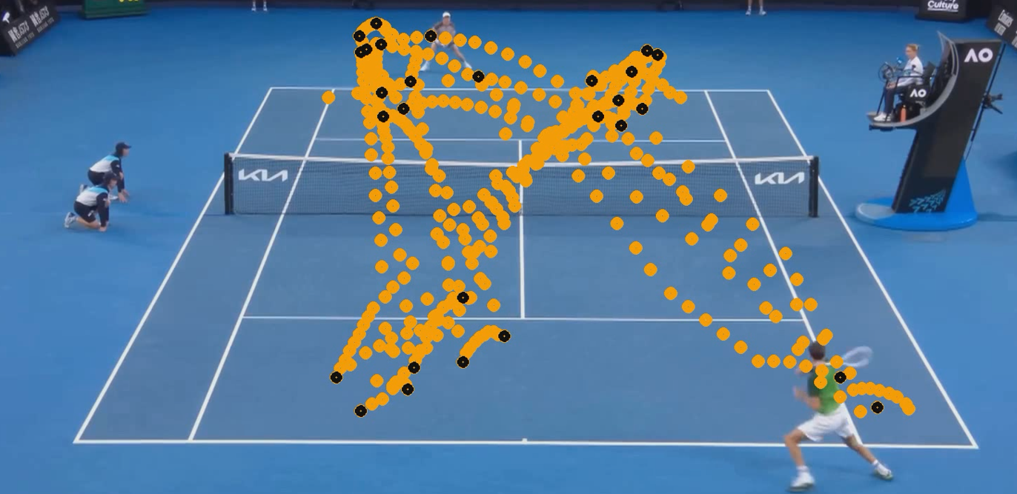
Tracking and bouncing results
The tracking of the ball showed a quite good accuracy to the intuitive reality of the track. The bounces were correctly identified in the overall as well.

Slide 23
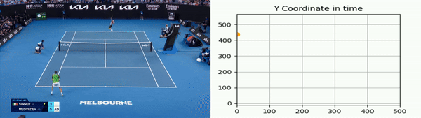
Tracking and bouncing results

Slide 24
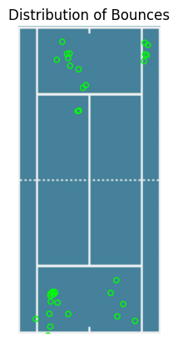
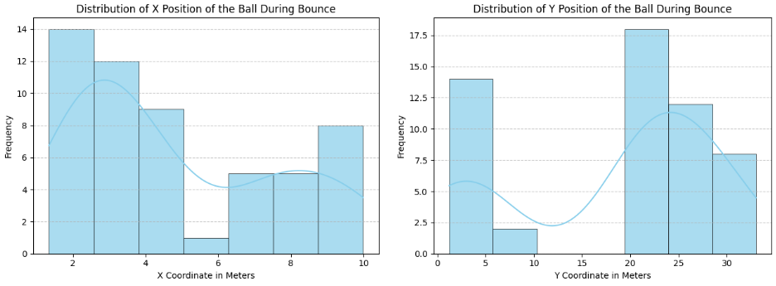
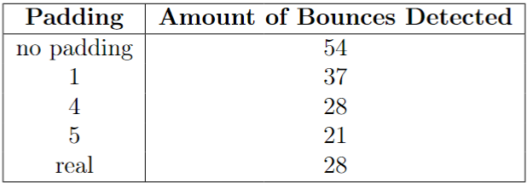
Absolute position of the bounces

Slide 25
06
Conclusions

Slide 26
Conclusion
Key Takeaways
Improvements
Future Features
The tracking of the ball was mostly satisfiable, as well as the data imputation;
The bounce identification has a high precision (everytime it identifies a bounce, it’s a bounce);
Traditional IACV techniques are really handy for current problems.
Increase robustness of the system to make a good result in any tennis match recording;
Make the system less dependable of padding and frame rate.
Further refactor the code used during the development in order to make it easier to other to use it;
Use a bigger frame rate and better “find peak” strategy to improve the coordinate accuracy.

Slide 27
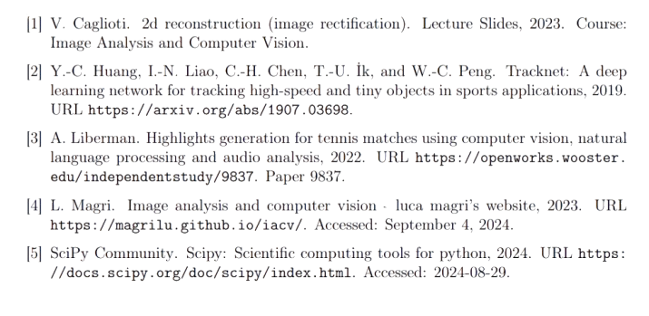
Bibliography

Slide 28
Thanks!
Do you have any questions?

